Slide 1
Modernize sales productivity Unlock productivity in the digital era

Slide 2
Age of distraction
Cost of distraction
59%
14%
59% of sellers say they have too many sales tools¹
Distractions reduce seller’s performance by 14%¹
50%
50% of workers don’t know what’s expected of them²
¹ Accenture
² Gallup
Notes:
One of the consequences of living in the digital era is that we are bombarded with information, short on attention, and driven to distraction. And sellers are not immune. They have to navigate data, processes, and tools while making sense of conflicting or unclear expectations. In fact, 59% of sellers say they have too many sales tools, and 50% of workers don’t know what’s expected of them. According to Accenture’s analysis, distractions reduce sellers’ performance by 14%, a significant cost to organizations.

Slide 3
And there’s more complexity
External
Internal
6.8
16
2x
72
# of stakeholders in B2B buying decision¹
Number of people internally needed to make a sale²
Number of teams people are on has doubled now vs five years ago³
% of the US workforce that will be mobile workers by 2020⁴
¹ CEB
² McKinsey
³ US IW Survey
⁴ IDC
Notes:
In addition to distractions, sellers face increasing complexity in today’s sales environment. Sellers have to juggle an average of 6.8 stakeholders and 16 colleagues per deal, resulting in longer and more complex sales cycles. Sellers are on twice as many teams now compared with just a few years ago, and they work while on the go, complicating collaboration efforts.
What can sales leaders do to drive sales productivity in an environment filled with distractions and complexity?

Slide 4
Do less, not more
Focus on what’s most important
Modernize sales productivity
Streamline seller workflows
Start with what you need
Notes:
Microsoft Dynamics 365 helps organizations modernize sales productivity in the face of these challenges. With Dynamics 365, sellers can do less, not more:
By focusing on what’s most important
With streamlined workflows
With sales tools tailored to just what they need
As a result, sellers can overcome the distractions and complexity to regain focus and sales momentum.

Slide 5
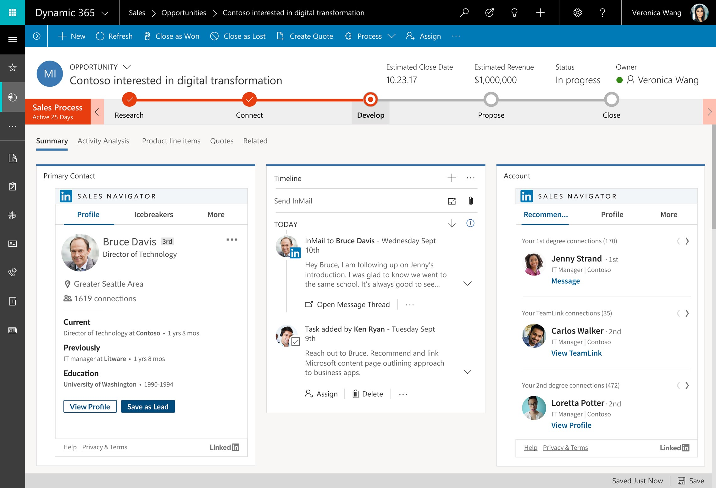
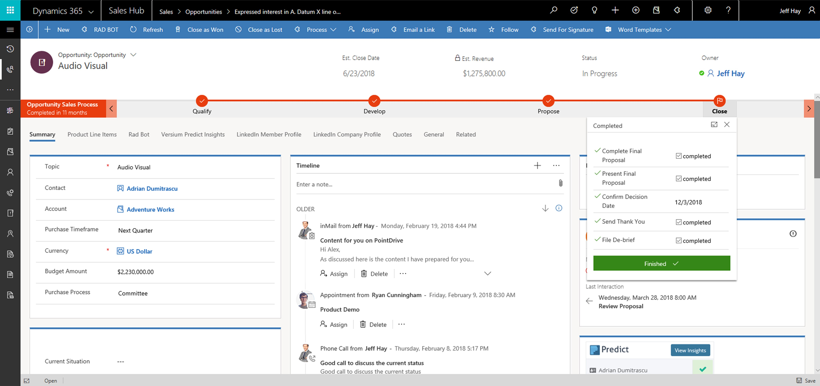
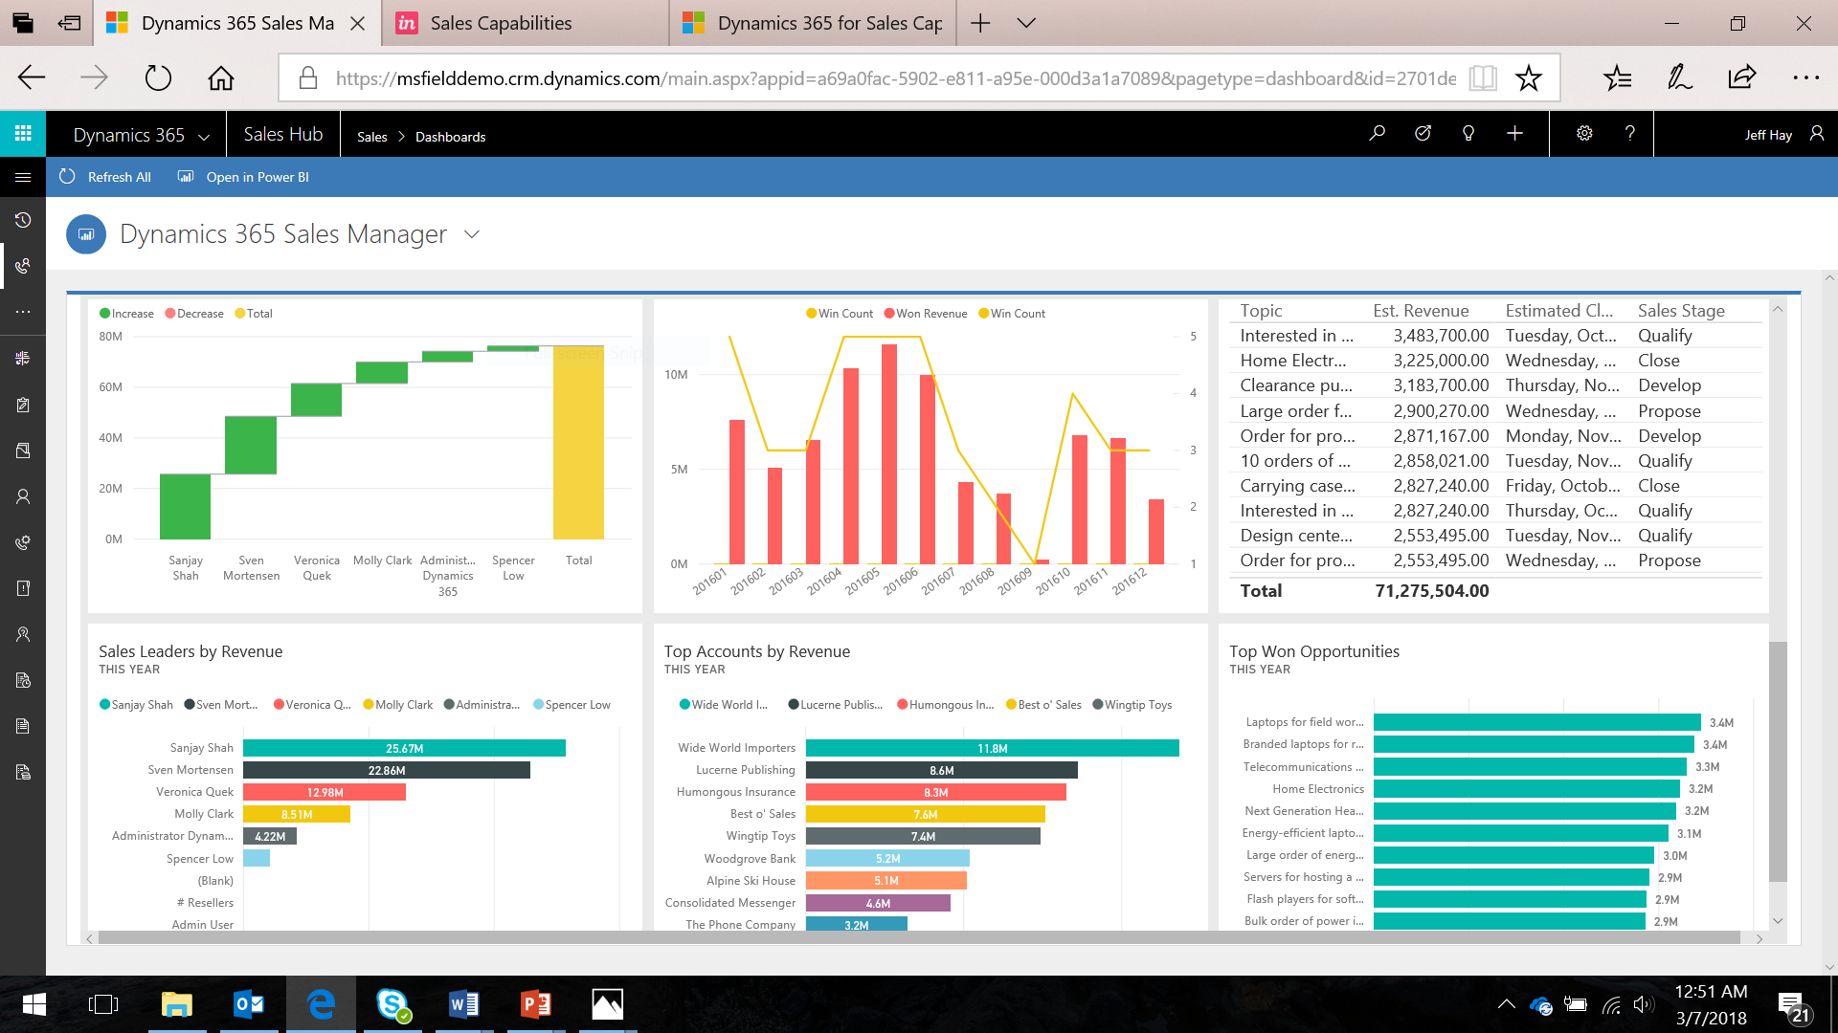
Focus on what's most important
Tailor interactions with customers
Get guidance toward optimal outcomes
Get actionable insights to increase performance
Notes:
Let’s take a look at how Dynamics 365 helps sellers focus on what’s most important.
1) As sellers juggle an increasing number of stakeholders, it gets harder to tailor and personalize interactions. Dynamics 365 provides a holistic view of the customer’s interaction history, so sellers have the context and knowledge to personalize every interaction with buyers.
2) To prevent distractions, organizations need to narrow down the optimal choices for sellers. With Dynamics 365, sellers get guidance toward optimal outcomes. Directly inside the sales records they are working on, sellers see the specific steps needed to move the deal forward.
3) As discussed earlier, many sellers are unclear of what’s expected of them. Is it just to close deals? Is it to build pipeline? Is it to acquire new customers, or retain existing customers? Frequently, goals conflict, creating distractions for sellers. Dynamics 365 provides contextual, real-time dashboards for sellers and leaders so the entire sales team knows what metrics to focus on and can take coordinated action toward the organization’s specific goals.

Slide 6
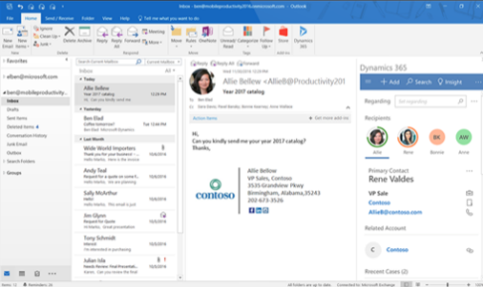
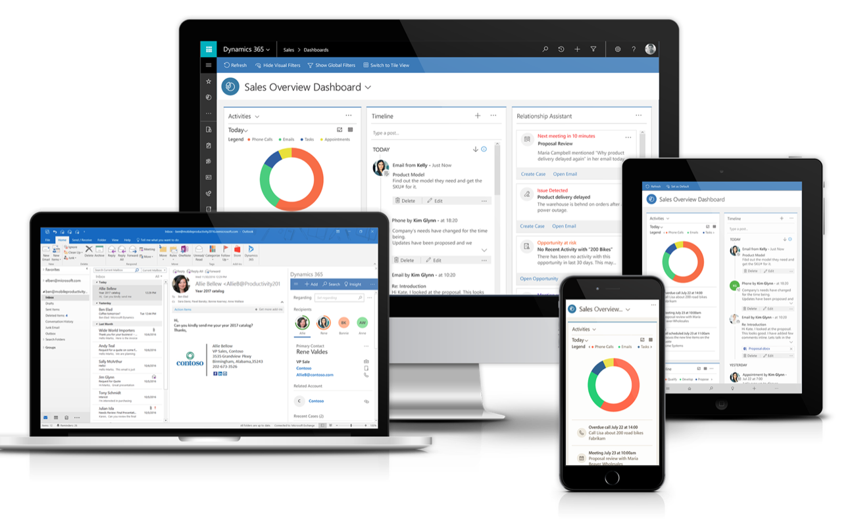
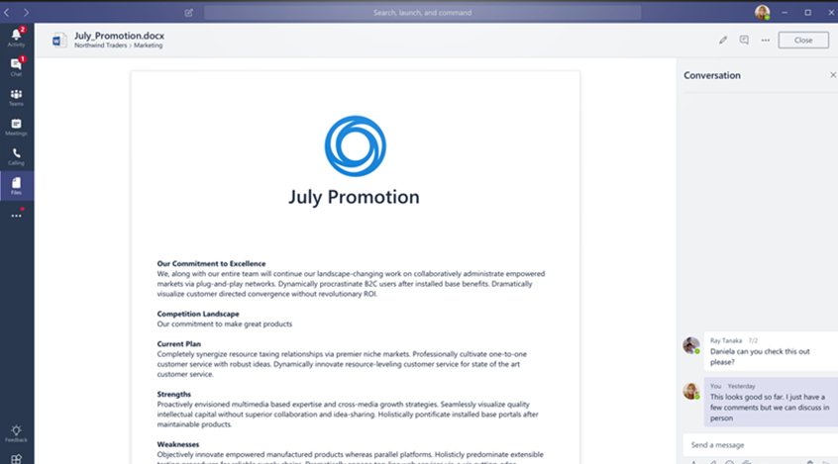
Streamline seller workflows
Conduct sales activities in familiar tools with Office 365
Work on the go with mobile application
Collaborate on deals in
a modern workspace
Notes:
Next let’s take a look at how Dynamics 365 streamlines seller workflows.
1) New sales tools, if not intuitive and integrated into the seller’s daily routine and workflow, will become a distraction. With Dynamics 365, sales capabilities are embedded inside familiar tools such as Office 365 where sellers already work. For example, sellers can create a new lead or view sales data about Dynamics 365 contacts and leads while working in Outlook.
2) As we mentioned earlier, today’s sellers work on the go. Modern sales tools need to support this contemporary mode of work. Dynamics 365 enables sellers to work anytime, anywhere with the mobile application across web, smartphone, and tablet. Sellers stay productive with mobile-optimized capabilities like voice-enabled commands, contextual news, and task flows that make it quick to conduct sales activities while on the road.
3) With more and more people involved in sales deals, sellers need new ways to collaborate. Dynamics 365 helps sellers collaborate on sales documents and stay connected to conversations around deals. You can even collaborate with customers or colleagues from other functions, while maintaining complete control over the data.

Slide 7
Start with what you need
Get up and running quickly
Configure the application for your specific sales processes
Count on a platform that grows with your business
Notes:
With Dynamics 365, you can start simple – with just the capabilities your sales teams need now – and support additional business needs as the business grows. The flexible and adaptable platform lets you get up and running quickly with pre-packaged applications, without the need to spend extra time and money setting up and deploying capabilities you don’t need right now. You can also configure the sales application for your specific sales processes, without technical resources. With Dynamics 365, you can count on a platform that meets your needs today and scales and adapts to your needs in the future. When your sales organization is ready, you can add more advanced capabilities in sales and beyond, from predictive lead scoring to LinkedIn integration to marketing to customer service.

Slide 8
Microsoft – a leader in seller productivity
Forrester Wave: Sales Force Automation Solutions
“Dynamics 365 brought a heightened focus on seller productivity, with deep integrations into Office 365 and Outlook.”
“Microsoft delivers on intelligent seller productivity.”
“Microsoft is a best fit for companies looking to capitalize on the productivity gains of their other Microsoft cloud investments, namely Office 365, and those companies that are bullish and looking to disrupt their peers with AI and machine learning.”
The Forrester Wave™ is copyrighted by Forrester Research, Inc. Forrester and Forrester Wave™ are trademarks of Forrester Research, Inc. The Forrester Wave™ is a graphical representation of Forrester's call on a market and is plotted using a detailed spreadsheet with exposed scores, weightings, and comments. Forrester does not endorse any vendor, product, or service depicted in the Forrester Wave. Information is based on best available resources. Opinions reflect judgment at the time and are subject to change.
Notes:
Forrester positions Microsoft as a Leader in their new Forrester Wave: Sales Force Automation Solutions. Forrester stressed in the report that today’s solutions focus on productivity AND seller empowerment.
The report placed Microsoft in the LEADER ripple, tied at the top for “current offering” combined with a perfect score on product vision in the “strategy” section. It is important to note that Microsoft leads all vendors in product vision as well. Microsoft received perfect scores in six different categories, the most among companies in the report. In addition to the strong placement, the write-up puts an emphasis on Dynamics 365’s strength in productivity and intelligence. Forrester concludes: "Microsoft is a best fit for companies looking to capitalize on the productivity gains of their other Microsoft cloud investments, namely Office 365, and those companies that are bullish and looking to disrupt their peers with AI and machine learning."

Slide 9
“Our people are loving the increased functionality; they can do more, more easily.”
Steven Hanna VP and CIO
Deployed Microsoft Dynamics 365 and increased sales productivity by 15–20%
Reduced distractions so salespeople could spend more time with customers
Provided a 360 degree view of customer for better decision-making
Notes:
Kennametal, a leading material science and manufacturing company, wanted to become a tighter-knit organization so that it could bring products to market more quickly, which is no small endeavor with 14,000 employees spread around the world. To extend communication and collaboration to factory workers and make it easier for all employees to share ideas and foster skills building, the company adopted Dynamics 365. Employees can now collaborate across locations and contribute to the company’s greater mission.
https://customers.microsoft.com/Pages/CustomerStory.aspx?recid=14603

Slide 10
“I was able to use CRM’s workflows and business rules to create a tool for our sales team that adds value by making it easier for them to do their job.”
Tom Faillace
Senior IT Generalist, Luck Companies
Deployed Microsoft Dynamics 365 and Office 365 to boost sales productivity and track sales performance
Each seller and sales leader saved approximately 3 hours per week with the solution
Achieved ROI of 308% and payback in 7.2 months
Notes:
Luck Stone is one of the largest providers of crushed stone, sand, and gravel in the US. After restructuring its sales strategy around a customer-centric model, Luck Stone deployed Dynamics 365 to give its sales team the tools they needed to succeed. Deploying Dynamics 365 kicked off a transformation that improved data capture and increased field sales effectiveness and sales management productivity. Luck Stone further improved sales effectiveness by linking Dynamics 365 to Office 365, which lets the sales staff communicate, collaborate, and view sales dashboards from within Dynamics 365.
https://customers.microsoft.com/en-us/story/luckstone

Slide 11
“We will be putting all information into one source and make it easily accessible. This enables us to be one step ahead – acting instead of reacting, no matter where we are.”
Christian Doose
EVP Sales, Swarovski Professional
Deployed Microsoft Dynamics 365 to connect global sales teams across channels and regions
Create a single platform for sales, marketing, and leadership to get a unified view of customers
Chose Dynamics 365 for superior usability, mobility, and integration
Notes:
Swarovski shines bright with better insight into their customers. Swarovski the world leader in precision-cut crystal and fashion jewelry wanted to boost sales performance. Swarovski chose Dynamics 365 because of its superior usability, mobility, and integration. With the solution, Swarovski is able to connect the global sales teams across all channels and regions to create a single platform for sales, marketing, and the leadership team in order to get a single, unified view of customers. This enables Swarovski to “be one step ahead – acting instead of reacting.”
https://customers.microsoft.com/en-us/story/microsoft-dynamics-crm-boosts-swarovskis-global-sales

Slide 12
A comprehensive solution for business growth and better customer service
Process over 500 orders a day helping scale the customer service operations
Faster response to customers and ability to expand business with confidence by automating financial and operational workflows
A single solution to manage everything from processing customer orders and making quotes to creating purchase orders and invoices
“If I get an email from a customer inquiring about an order, I just click on the Dynamics 365 add-in within Outlook. It pulls up all of the linked documents within the email message, so I don’t have to go to another app to find the information.”
Christopher Gates, Business Operations Manager
Notes:
Established in 1956 to provide affordable footwear to US Marines and others, the small company transformed its business processes with Microsoft Dynamics 365. Now, Quantico Boot can automate financial and operational workflow, respond faster to customers, and expand business with confidence.
With Dynamics 365, sellers have one streamlined workflow that connects Outlook and sales capabilities. Sellers can see sales data directly inside emails. Having the essential sales data directly inside emails means sellers can respond quickly to customers and stay productive since they don’t have to switch between apps to complete common sales activities.
https://customers.microsoft.com/en-us/story/quantico-boot

Slide 13
Learn how to modernize sales productivity with Dynamics 365 for Sales
Watch how customers are modernizing sales productivity with Dynamics 365
Dive in and learn more about the latest capabilities here
Get started with affordable and predictable packaged services

